Slide 1
Diwali sales analysis
Ruchi Gupta (AF0461344)

Slide 2
About my project
Diwali Sales Data Analysis Using NumPy, Pandas, Seaborn, and Matplotlib
Diwali is one of the biggest shopping festivals in India, with massive sales across various sectors. Analyzing Diwali sales data using NumPy, Pandas, Seaborn, and Matplotlib helps derive insights into customer behavior, product demand, and revenue trends.
#over all output of this analysis.. Married women age group 26-35 years from UP, Maharashtra and Karnataka working in IT, Healthcare and Aviation are more likely to buy products from food ,clothing and Electronics category.

Slide 3
objectives
1.Understand Customer Behavior
2.Identify Top-Selling Products & Categories
3.Analyze Sales Trends & Performance
4.Optimize Business Strategies
5.Visualize Insights Effectively

Slide 4
The Collection
Steps Involved in the Analysis:

Slide 5

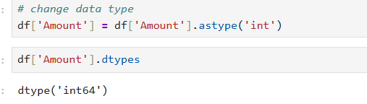
Data Collection & Preprocessing
Load the dataset using Pandas (pd.read_csv()).
Handle missing values and clean data (dropna(), fillna()).
Convert data types if necessary.

Slide 6
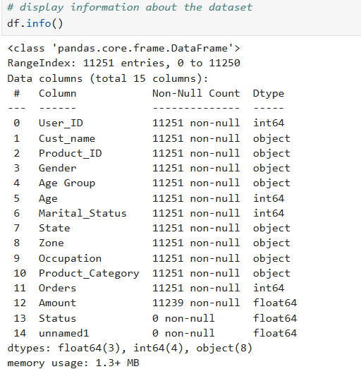
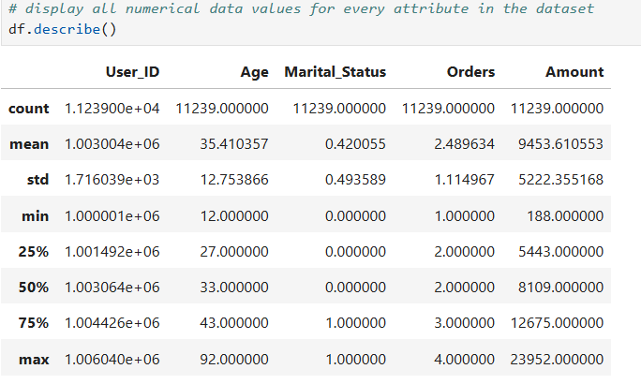
Exploratory data analYSIS
Use Pandas to summarize data (describe(), info()).
Identify sales trends based on categories like gender, age group, city, product category, and payment method.

Slide 7
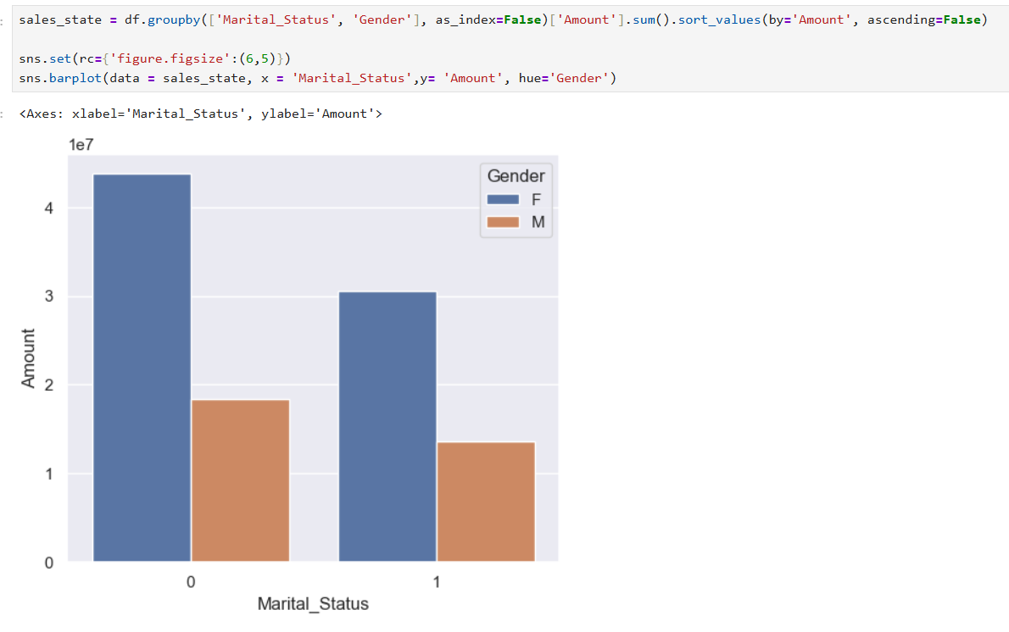
Data
visualization
Matplotlib: Create bar charts, line graphs, and pie charts to understand trends.
Seaborn: Generate heatmaps, box plots, and count plots for deeper insights.

Slide 8
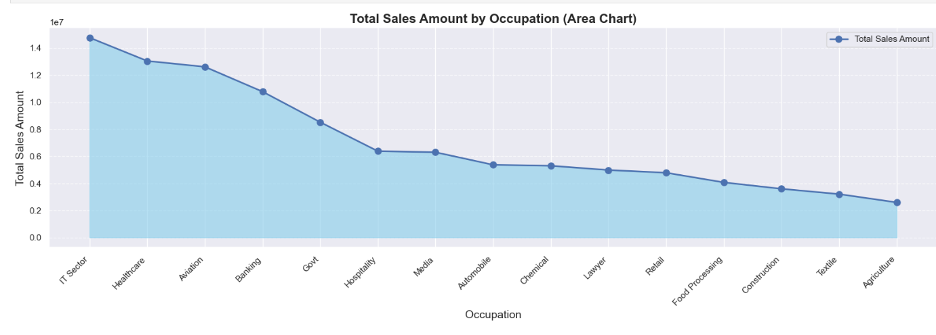
Visulaization

Slide 9
Conclusions & tools
Recognize peak shopping trends, high-revenue products, and customer demographics.
Recommend strategies for future sales campaigns.
Tools Used:
NumPy: Numerical computations
Pandas: Data manipulation
Seaborn: Statistical data visualization
Matplotlib: Graphical representation

Slide 10
Thank you!

